Slide 1



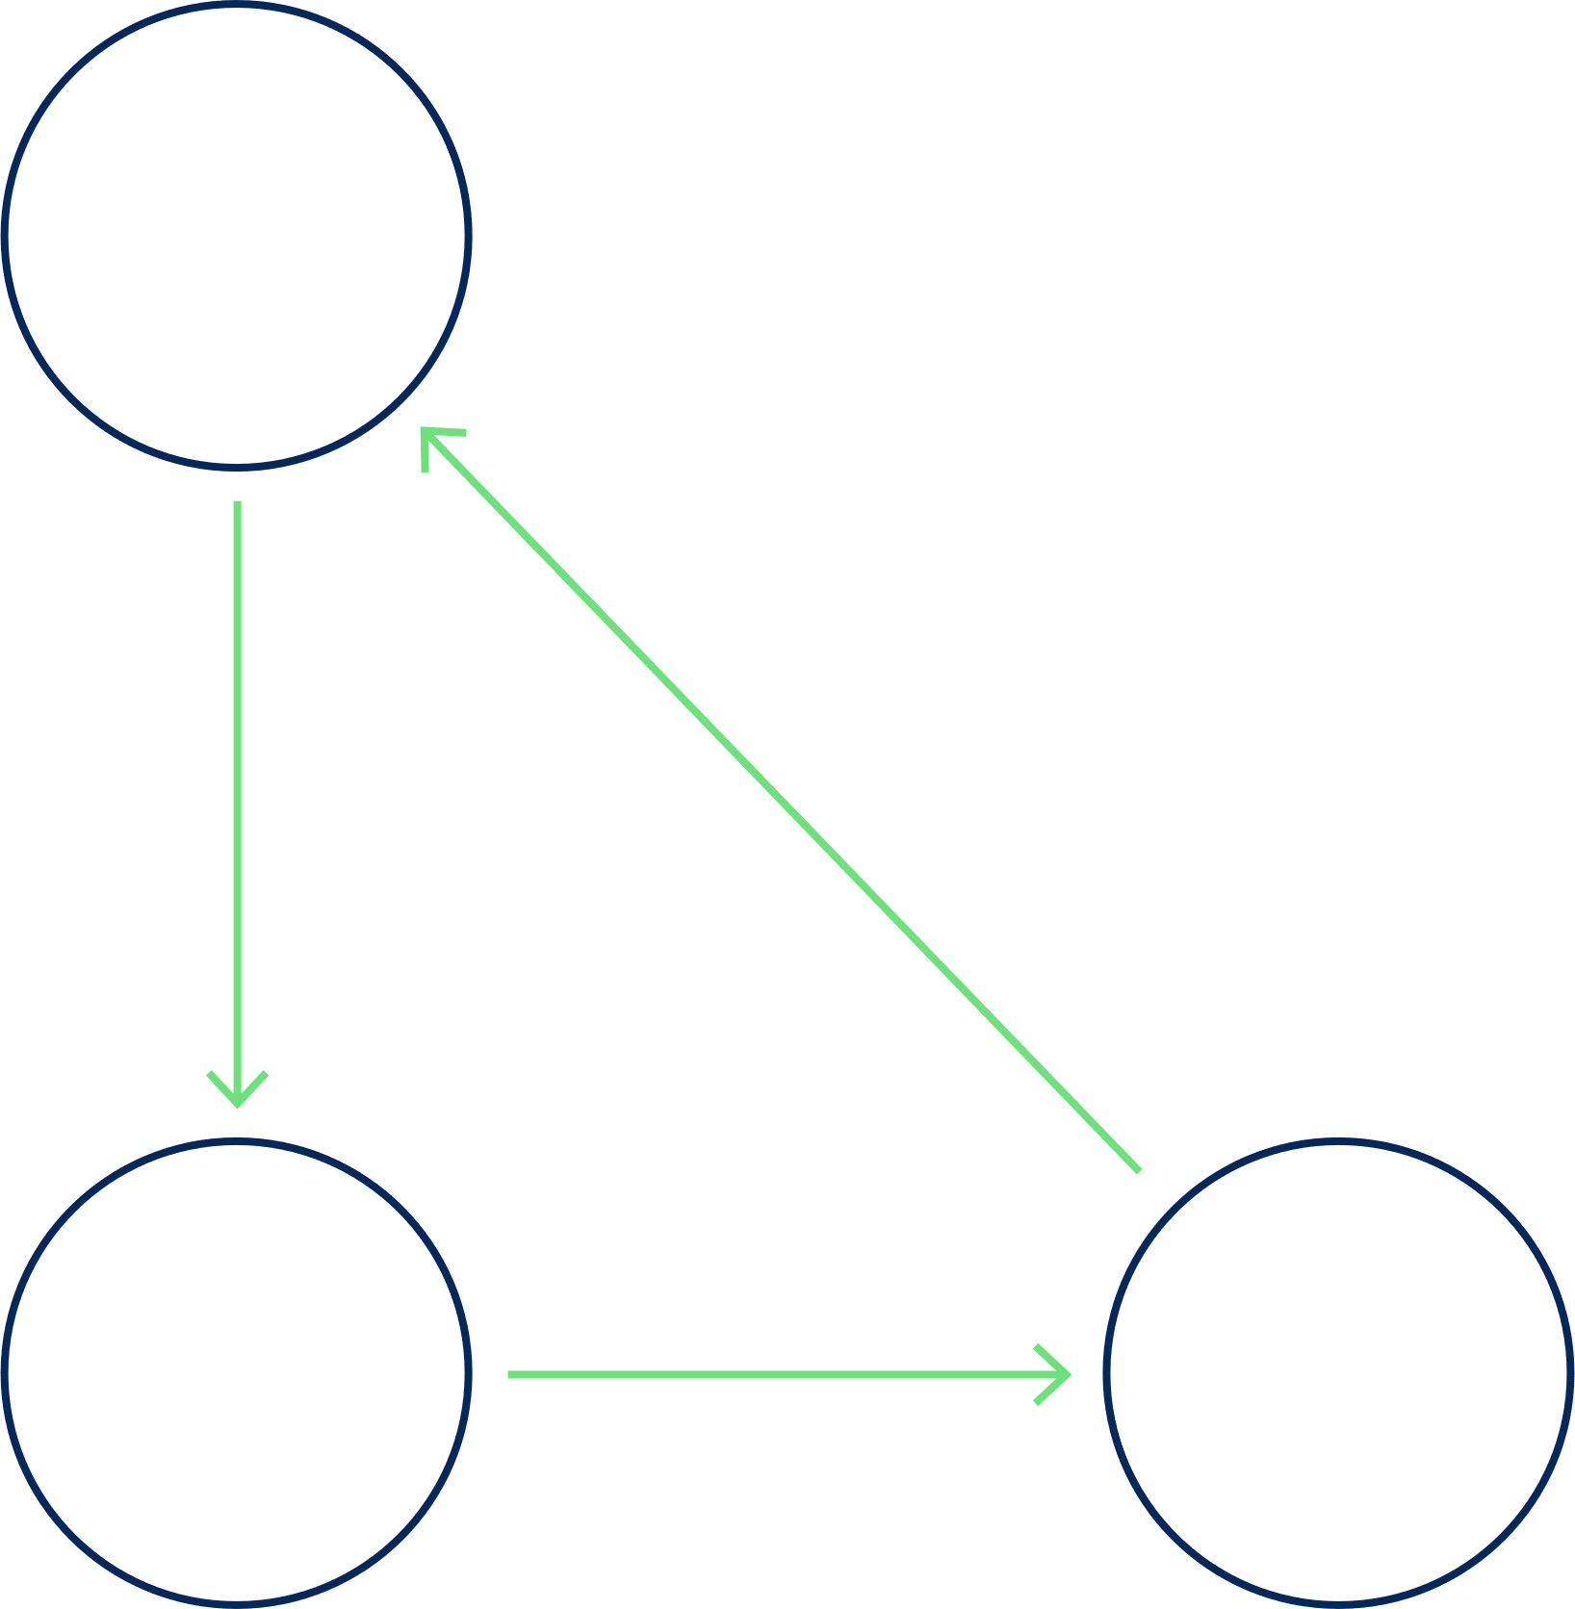
Invisible Threats Cybersecurity
The Rise of Fileless Malware
Sadid Ahmed
ID : 0242220005101437

Slide 2



Understanding Fileless Malware
01
Definition of Fileless Malware
Fileless malware operates in-memory rather than relying on files, making it invisible to traditional antivirus solutions.
02
Differences from Traditional Malware
Unlike traditional malware, fileless variants do not leave behind traces on disk, making detection more challenging for security systems.
03
Impact on Systems
The impact of fileless malware can be severe, leading to data breaches, system corruption, and significant operational disruptions.

Slide 3

INITIAL ENTRY POINT
EXPLOITATION OF VULNERABILITY
Malware enters through vulnerable software or phishing emails.
Once inside, it exploits system vulnerabilities to execute.
EXECUTION OF CODE
PERSISTENCE AND CONTROL
The attack executes in-memory without storing files on disk.
The attacker gains backdoor access for ongoing control.

Slide 4




Advanced Persistent Threat (APT) groups use fileless malware to evade detection.
These attacks are often targeted, exploiting vulnerabilities in organizations for long-term access and data exfiltration.

Slide 5


Why Is Fileless Malware Dangerous?
01
Traditional security measures
Fileless malware evades detection by traditional antivirus programs, allowing it to operate without leaving typical signatures that would trigger alerts.
02
Persistence in environments
Once executed, fileless malware can remain within a system's memory for extended periods, making it difficult to remove or detect.
03
Challenges in detection
The invisibility of fileless malware complicates detection efforts, requiring advanced tools and methodologies to identify and respond effectively.

Slide 6

Key Strategies for Defense
01
Endpoint Detection
Implement advanced endpoint detection tools to identify and respond to threats in real-time.
02
Behavioral Analytics
Utilize behavioral analytics to detect anomalies and potential threats based on user behavior patterns.
03
Security Awareness Training
Conduct regular security awareness training for employees to recognize phishing attempts and other social engineering tactics.

Slide 7


Thank You
Any Question ?

